Slide 1

Computing Asymptotic Bounds for Small Roots in Coppersmith’s Method via Sumset Theory
Yansong Feng, Hengyi Luo, Qiyuan Chen, Abderrahmane Nitaj, Yanbin Pan.
AMSS, CAS, China
Normandie University, France
2025/08/19

Slide 2
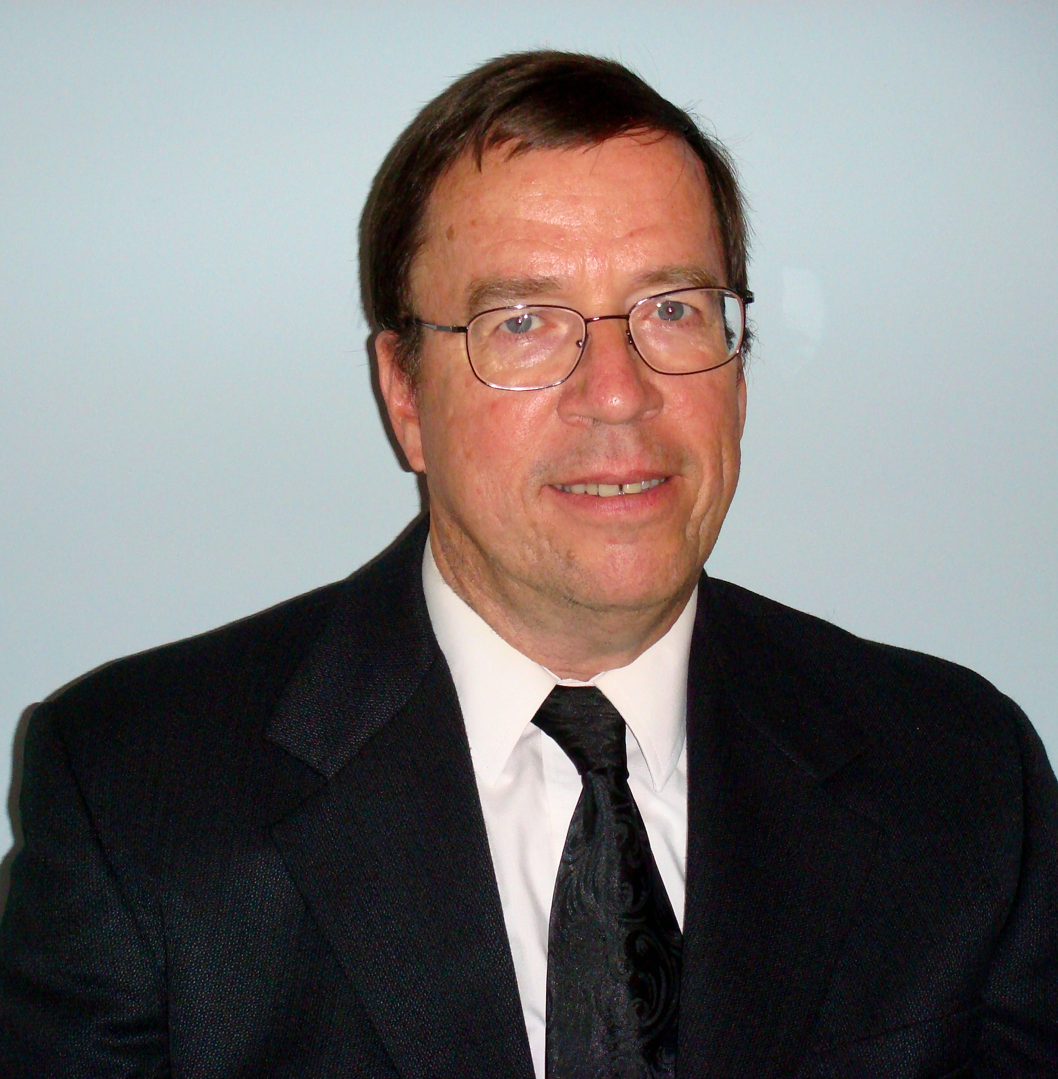
Coppersmith’s Method
Don Coppersmith, awarded as The Levchin Prize for foundational innovations in cryptanalysis.
PART 01
1/21
Notes:
模板来自于：第一PPT https://www.1ppt.com/

Slide 3
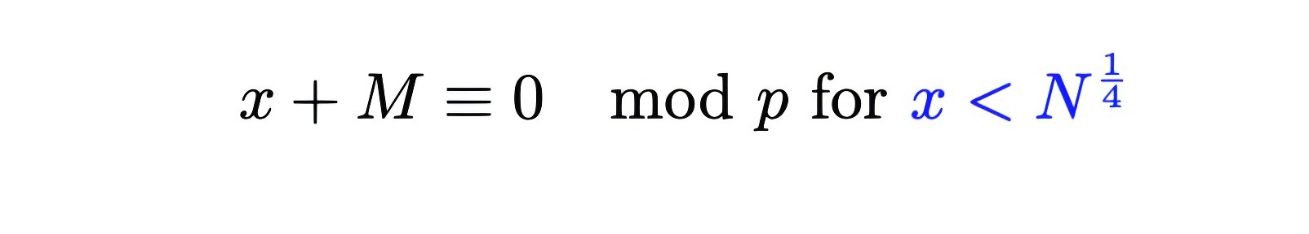

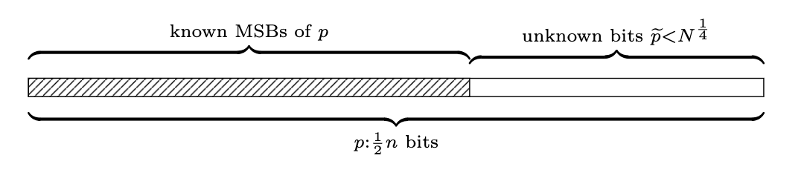
What’s this?
Solving small roots of polynomial equations effciently
Partial Prime Factor Exposure Attack
2/21

Slide 4
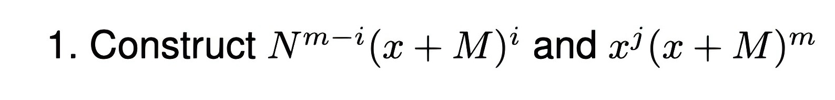
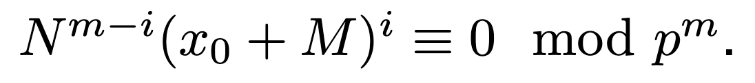
How it works?
3/21

Slide 5
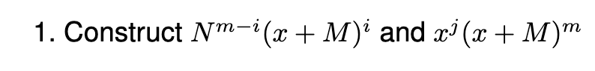
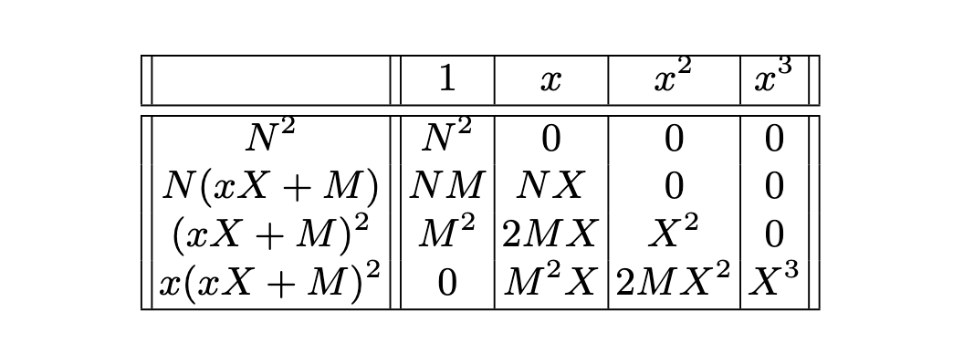
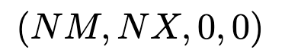
How it works?
4/21

Slide 6
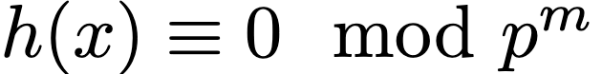

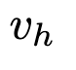
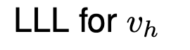
How it works?
5/21

Slide 7
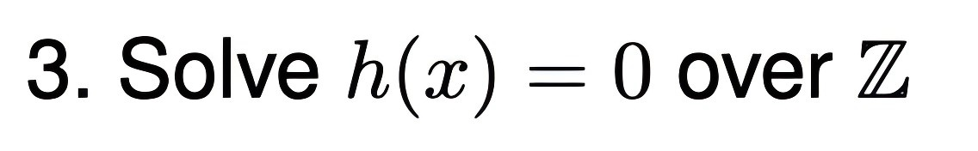
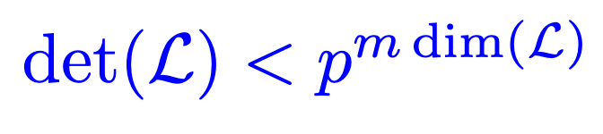
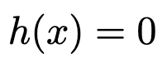

How it works?
6/21

Slide 8
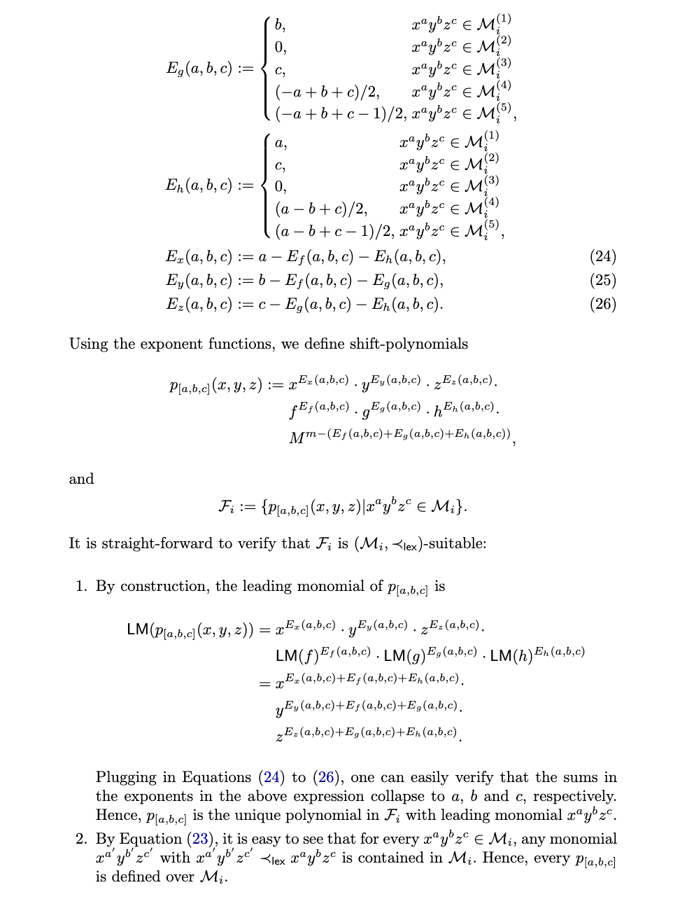

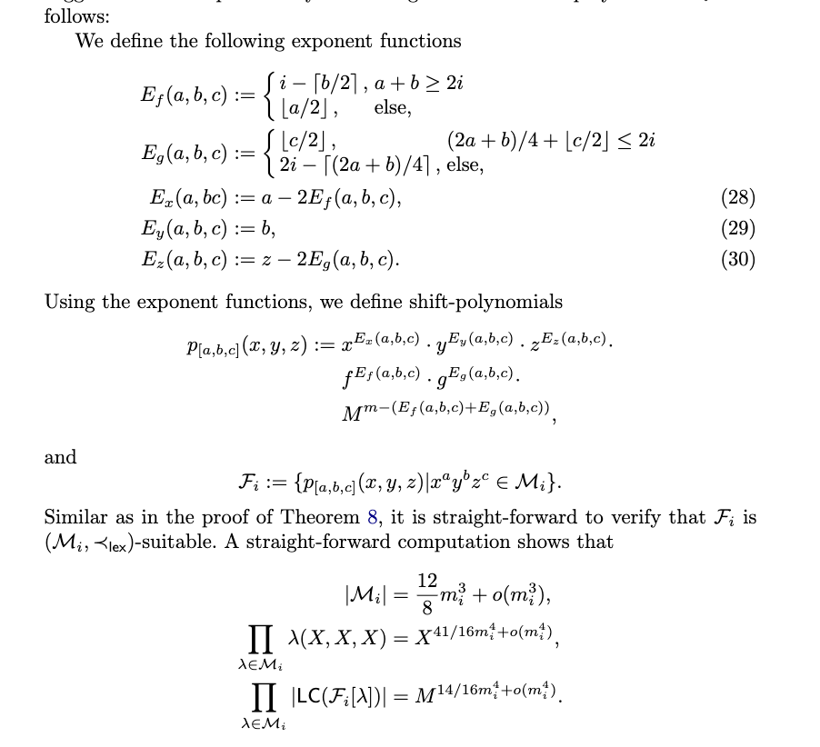
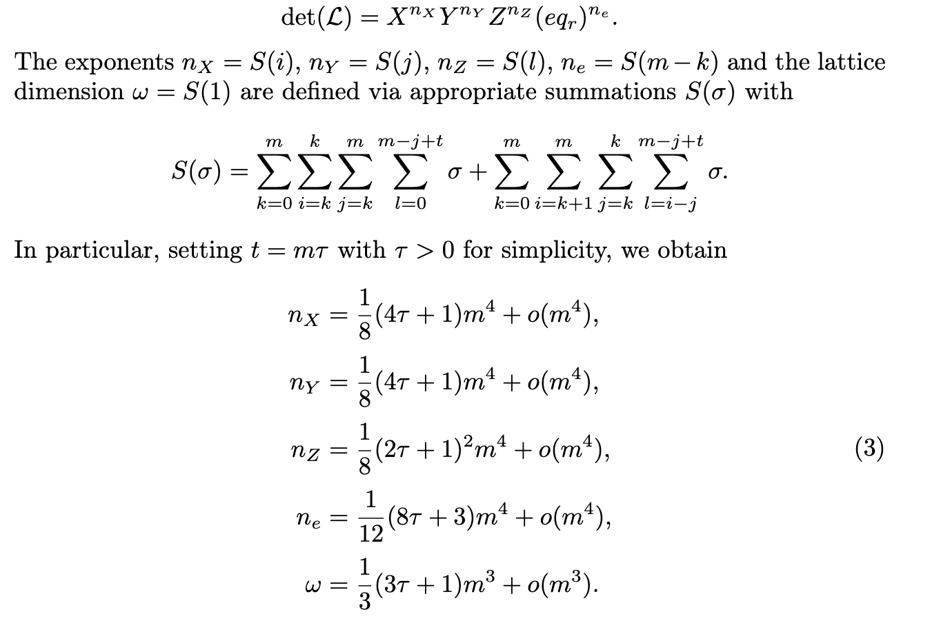
Difficult examples
7/21

Slide 9
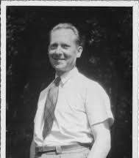
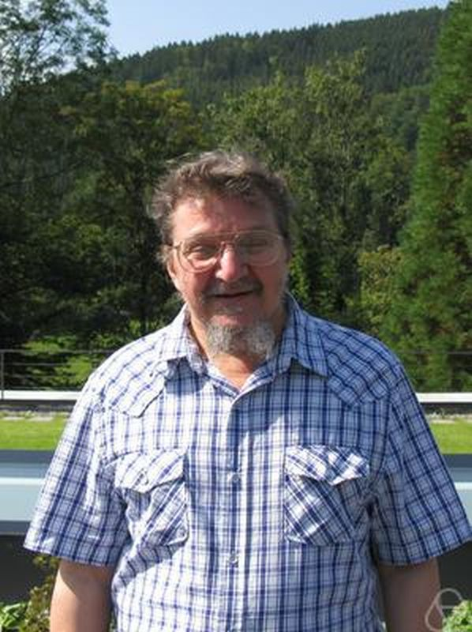
A New Tool from Additive Combinatorics!
PART 02
1960s
1992
Eugène Ehrhart
Askold Khovanskii
8/21

Slide 10

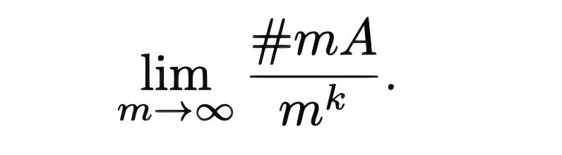
Rewitten Dimension
9/21

Slide 11
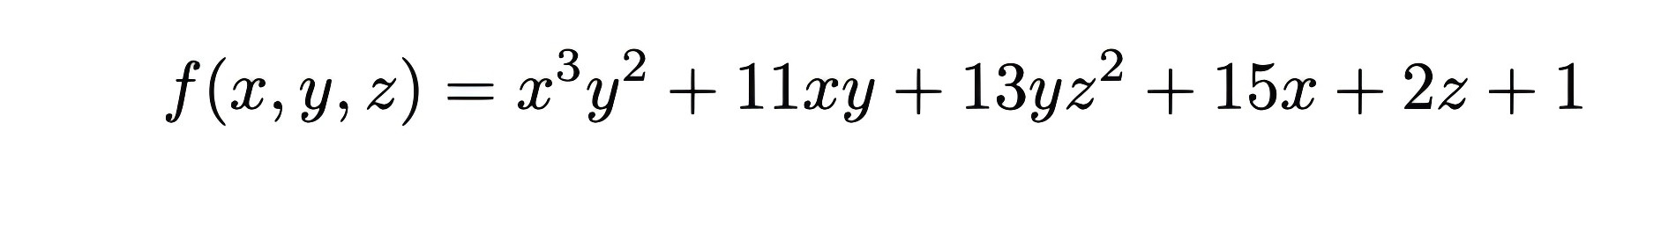
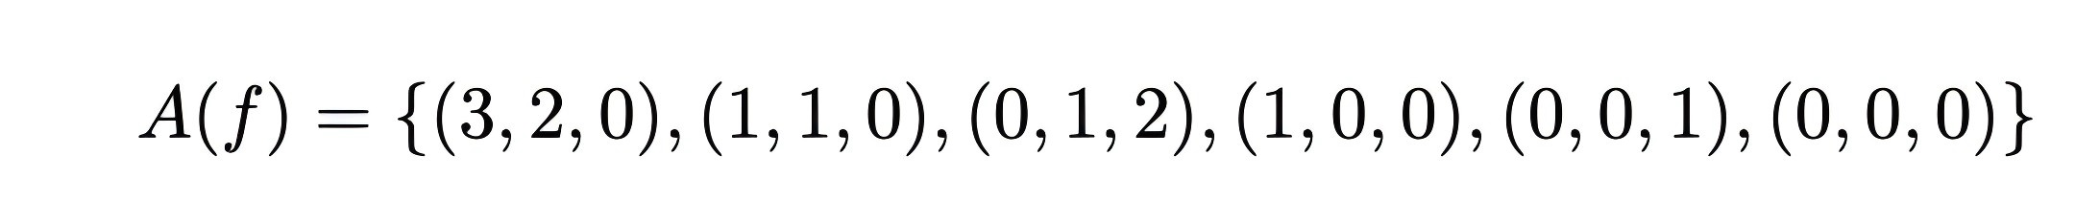
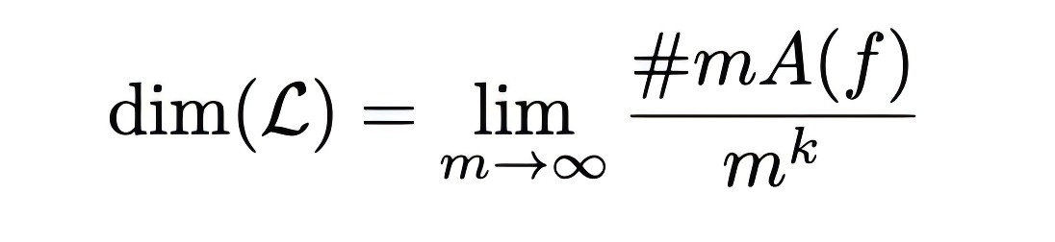
Why dimension?
10/21

Slide 12

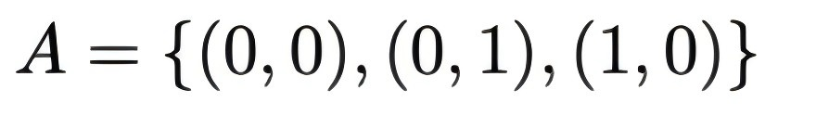
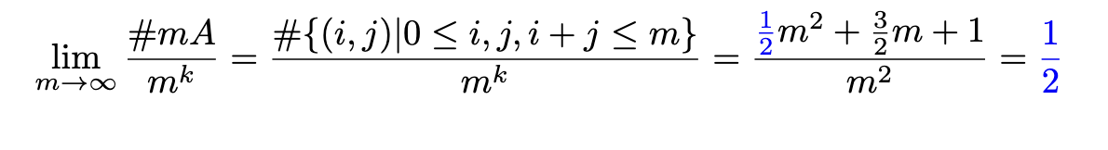

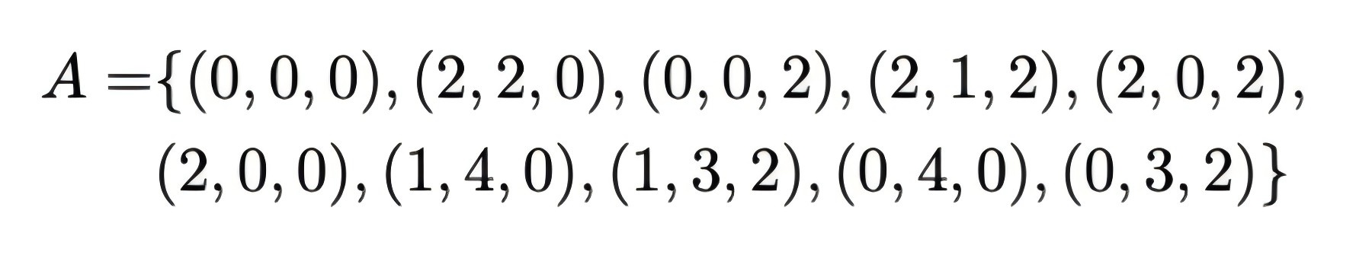
Rewitten Dimension
11/21

Slide 13
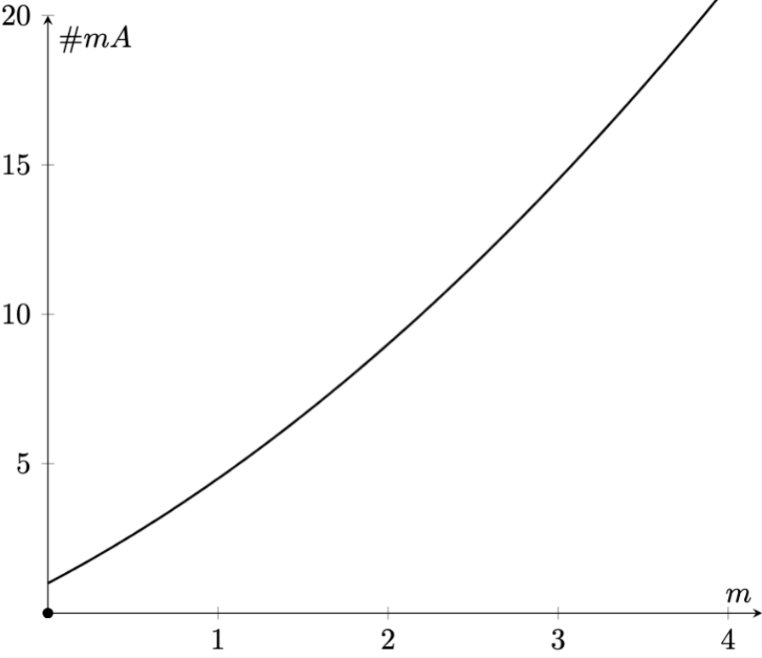
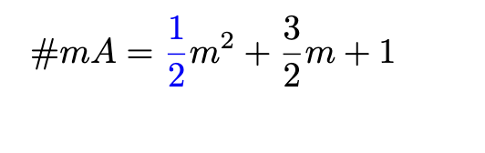
Heuristic Try
Lagrange interpolation
12/21

Slide 14

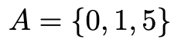
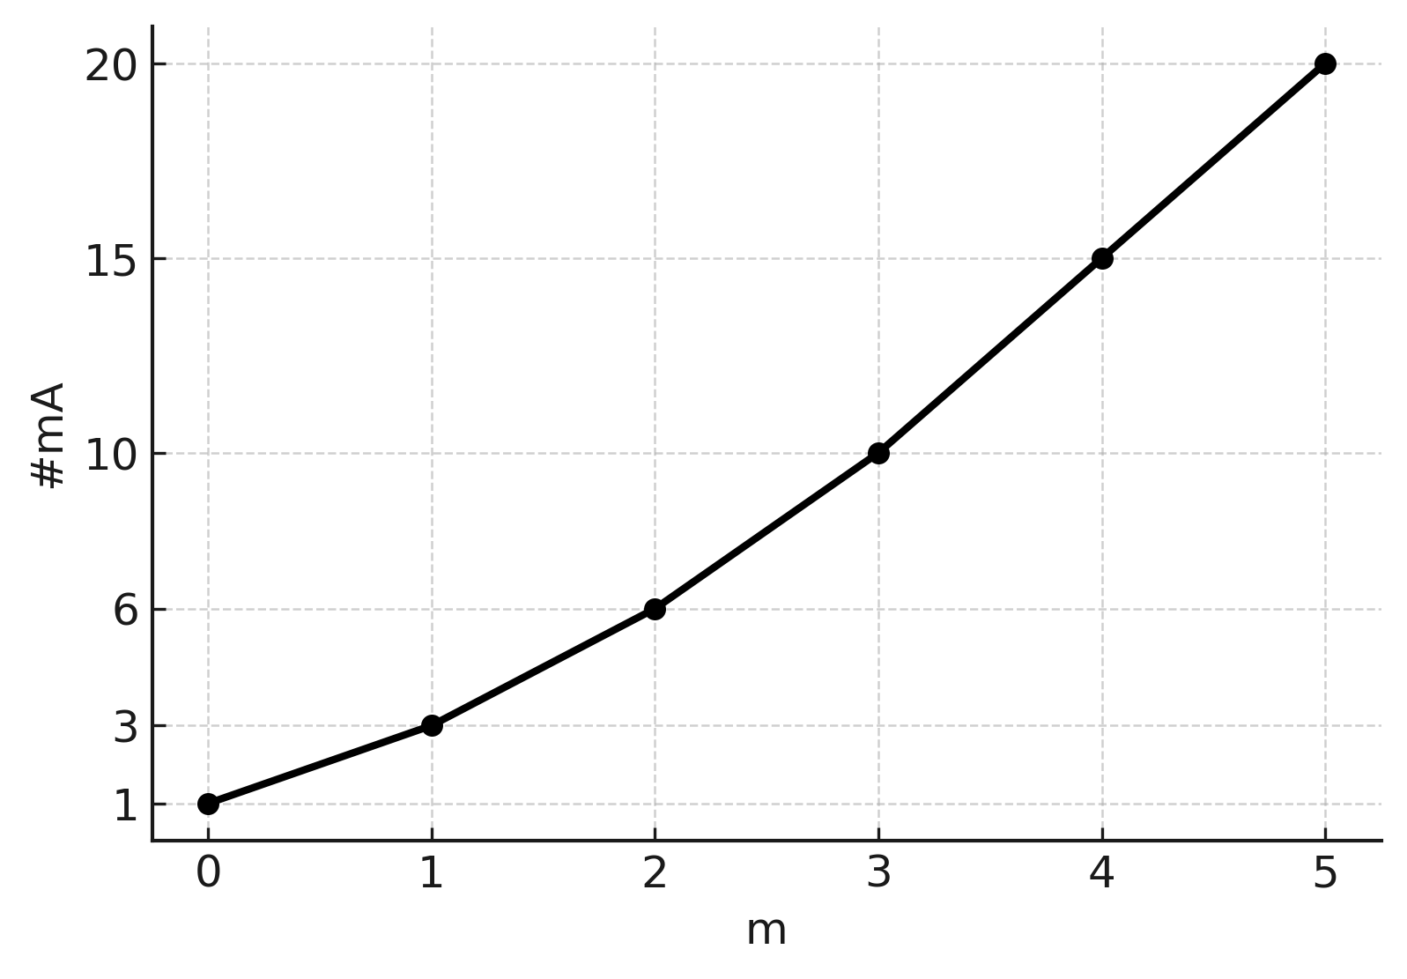
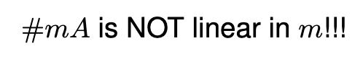
Heuristic Try
Conterexample
Lagrange interpolation
13/21

Slide 15


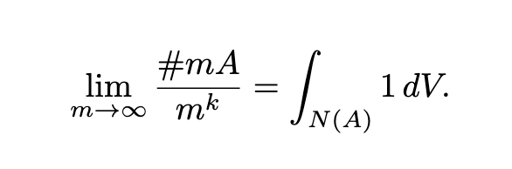
Polytope!
14/21

Slide 16
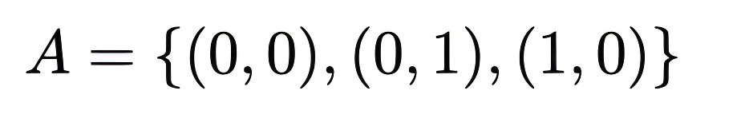
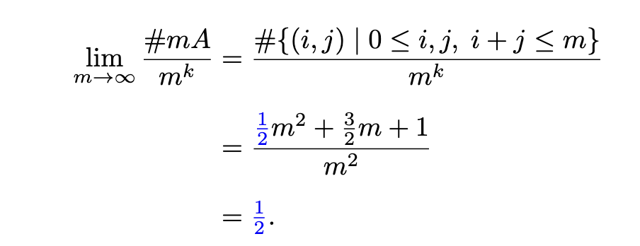
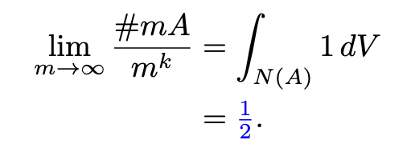
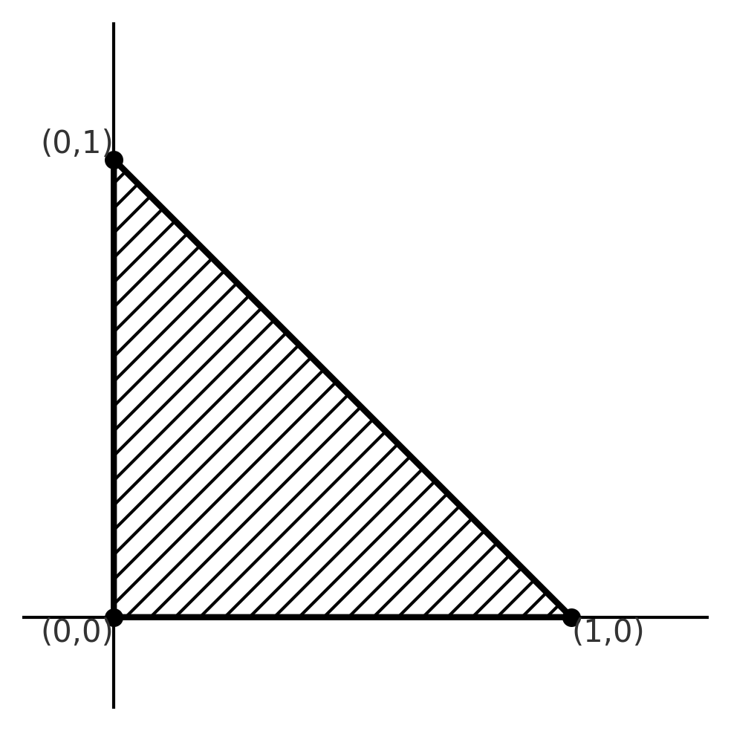
Manual Calculation V.S. Polytopes
15/21

Slide 17
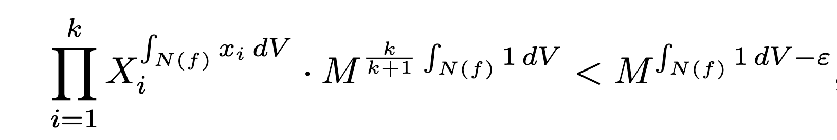
Provable Asymptotic Bounds
PART 03
16/21

Slide 18
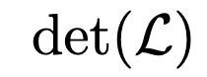

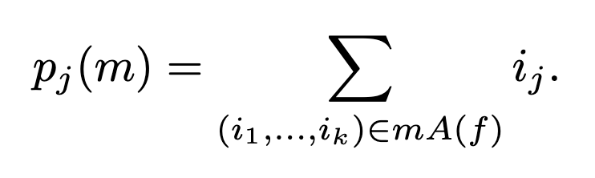
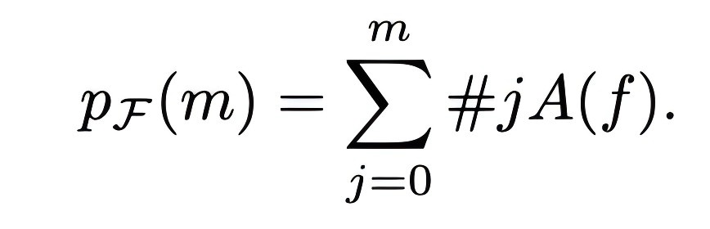
17/21

Slide 19
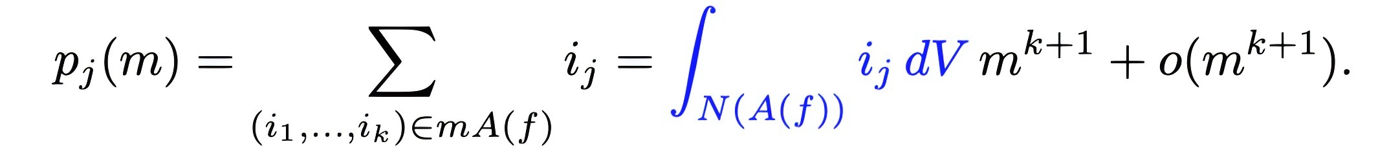
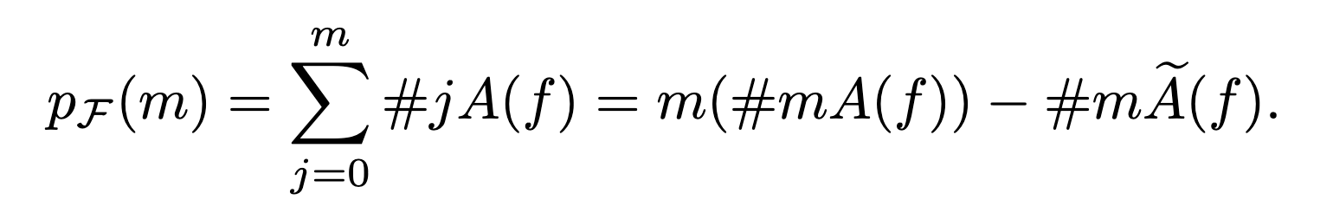
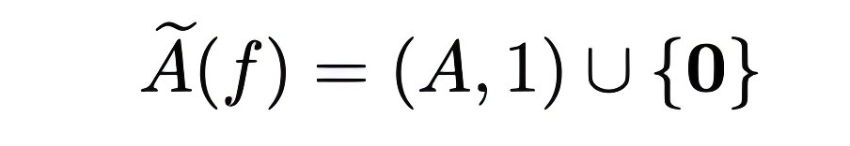
Polytope is all you need!
18/21

Slide 20


In practice
Computer-friendly for input!
19/21

Slide 21


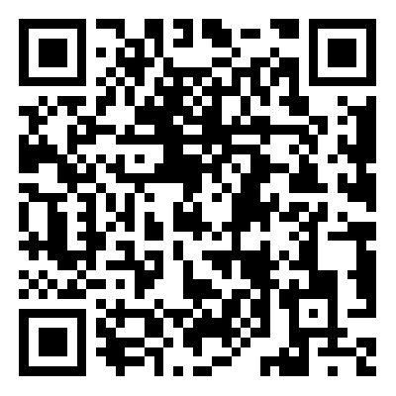
Thank you!
Speaker: Yansong Feng
fengyansong@amss.ac.cn
Paper
eprint:2024/1330
Code
fffmath/AsymptoticBounds

